Slide 1
INFERENTIAL STATISTICS

Slide 2
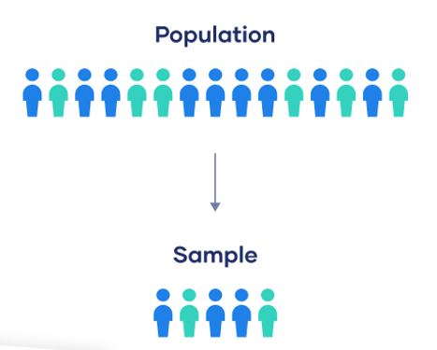
What is Inferential Statistics?
Inferential statistics is a way of making inferences about populations
based on samples.
Population : A population is the entire group
that you want to draw conclusions
about.
Sample : A sample is the specific group that you
will collect data from.
The size of the sample is always less than the total size of the population.

Slide 3
Sample statistic (SS) : Single number calculated on the basis of the data collected from a sample
Population parameter (PP) : Single number calculated on the basis of the data collected from a population
Example :
results of exit poll or opinion poll - sample statistic
results of election commission - population parameter
PP – want to know
SS - what u actually know
SS and PP may not be equal to each other

Slide 4
SS = PP + Bias + Chance variation
Bias - inclination towards or against a group without any
substantial facts
Chance variation – it is bound to occur unless and until data is
collected from the entire population

Slide 5
Confidence level : It means …whatever the result given by a person is purely correct…..
Default value of Cl = 95%
5% chance of me giving you a wrong result
If you wish CL =100%, then sample size = population size. In this case, the chance variation would NOT be there .
Example :
If Vishal reports the rating to be between 7 and 9 @ 95% CL, this means he wants to tell me that if I collect the PP, then there is a 95% chance for that to be between 7 and 9. So, 5% chance that it could either be less than 7 or more than 9.

Slide 6
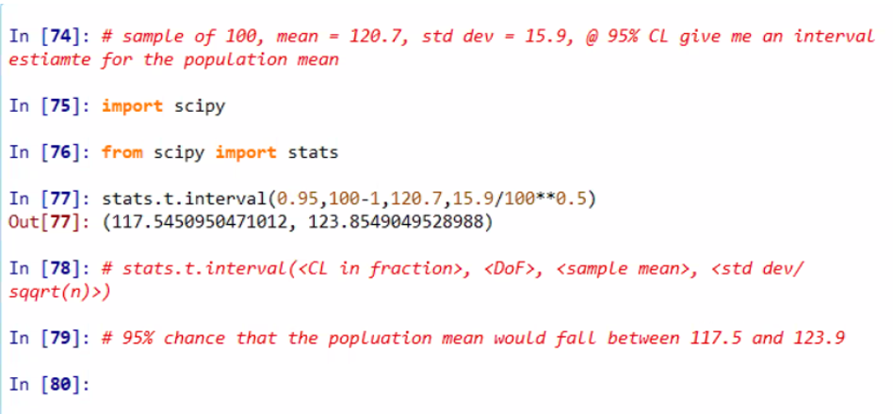

Slide 7
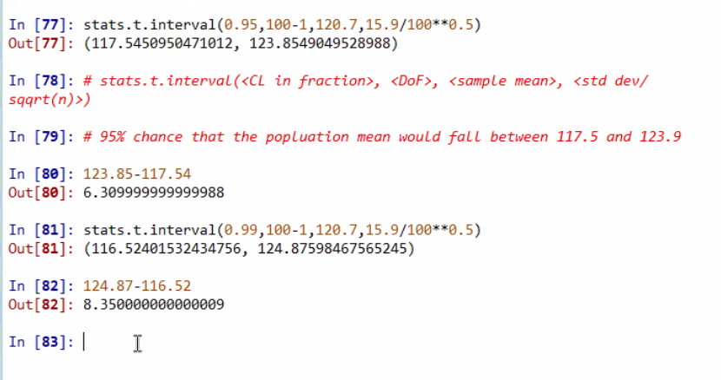
As we increase the confidence level say to 99%, will the interval increase ? YES

Slide 8
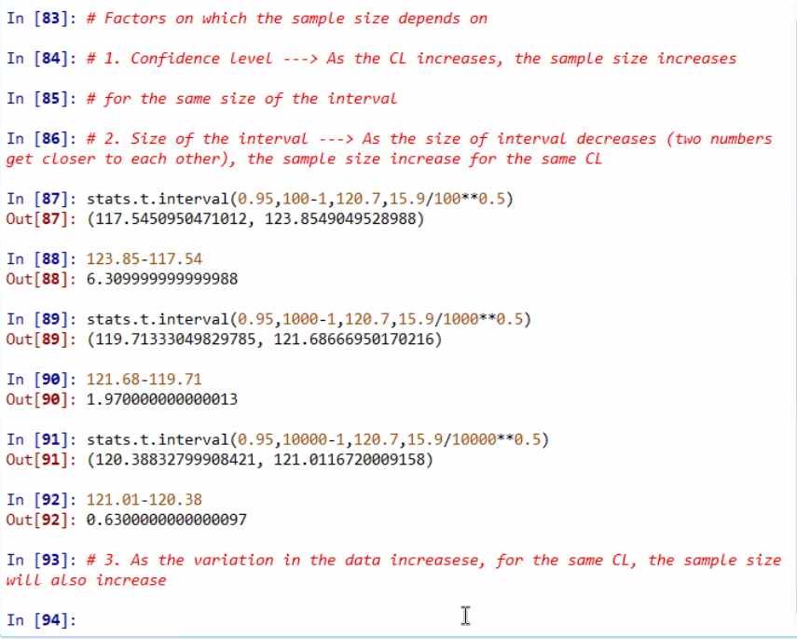

Slide 9
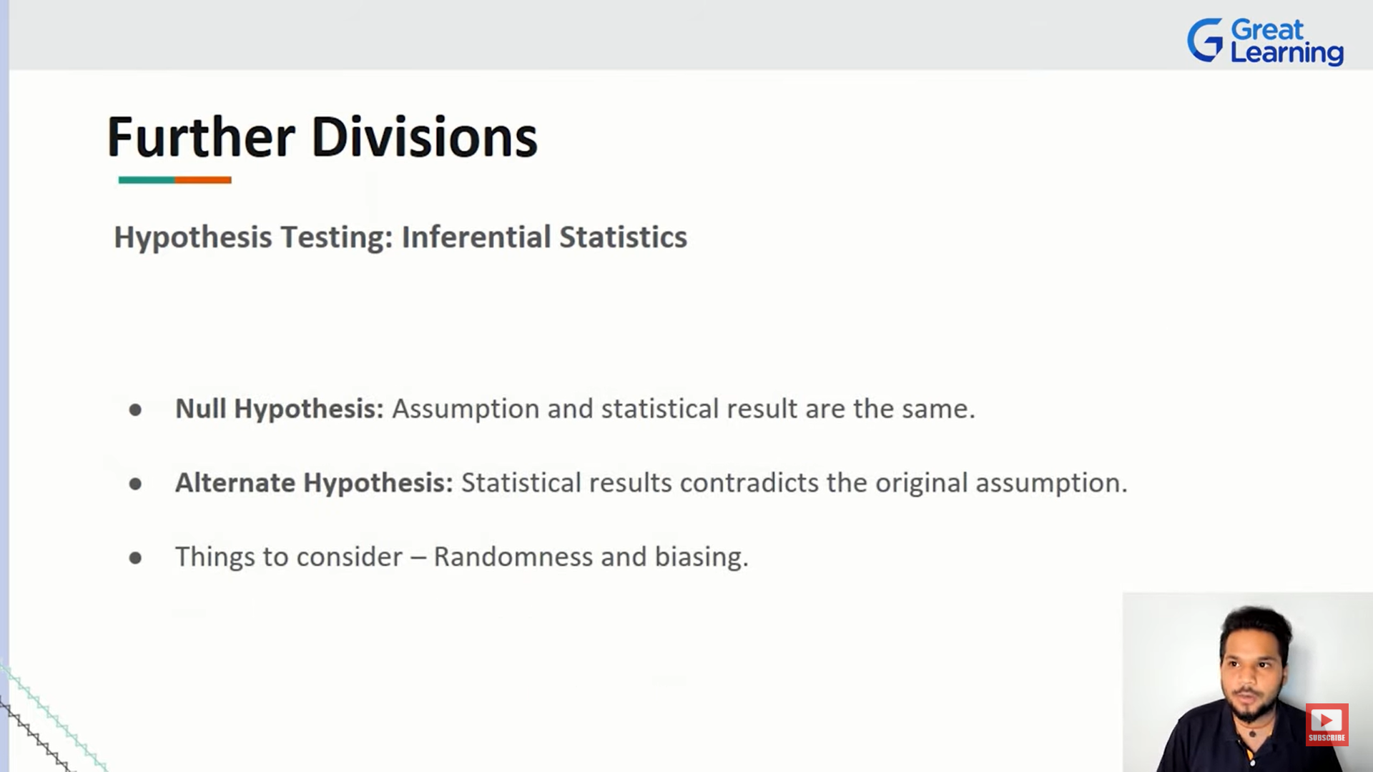
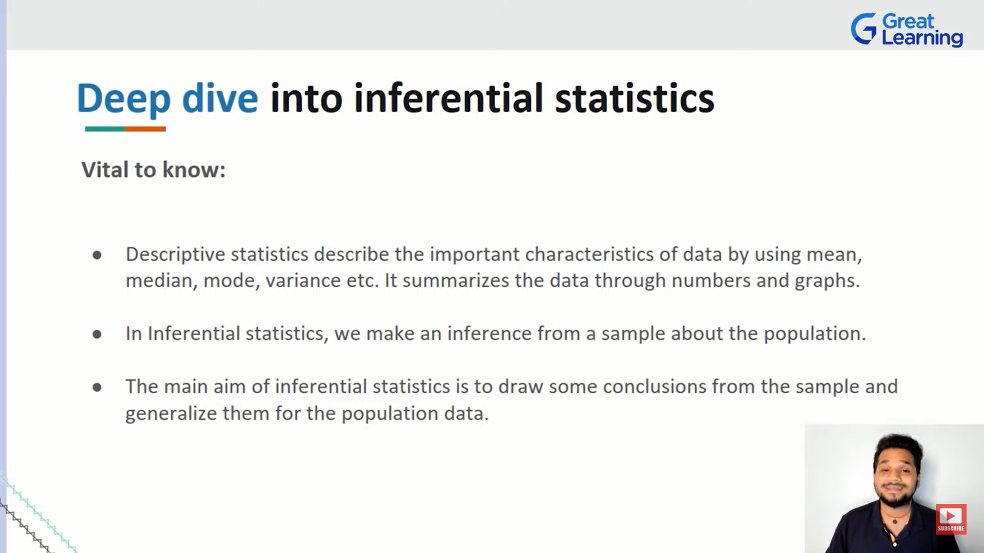

Slide 10
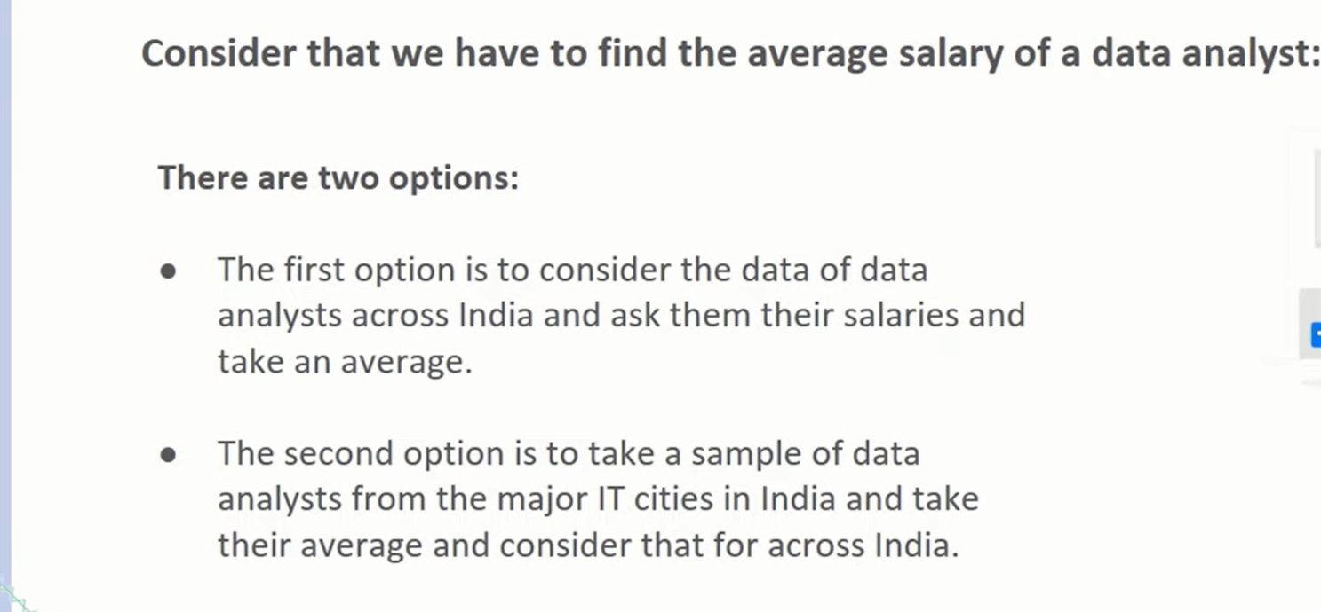

Slide 11
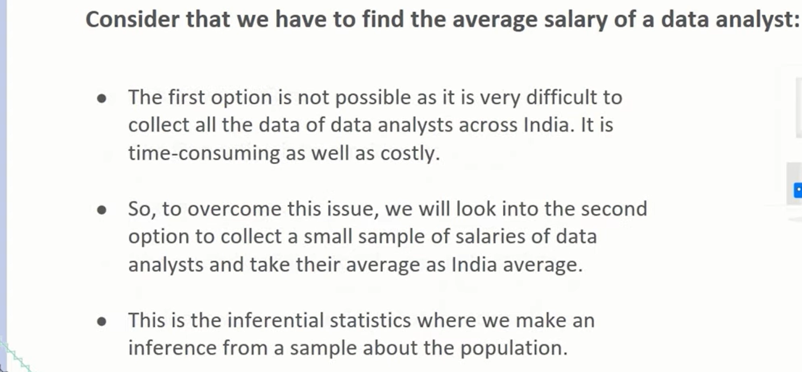

Slide 12
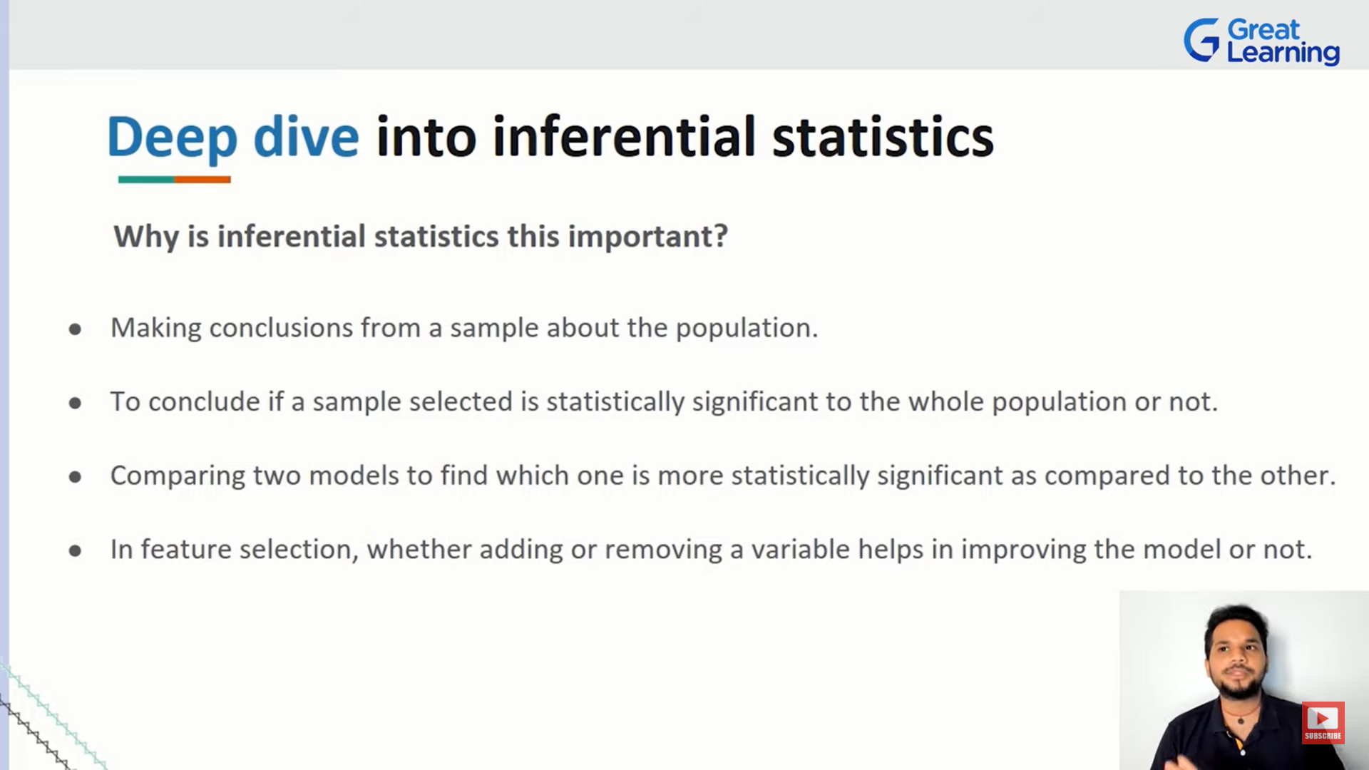

Slide 13
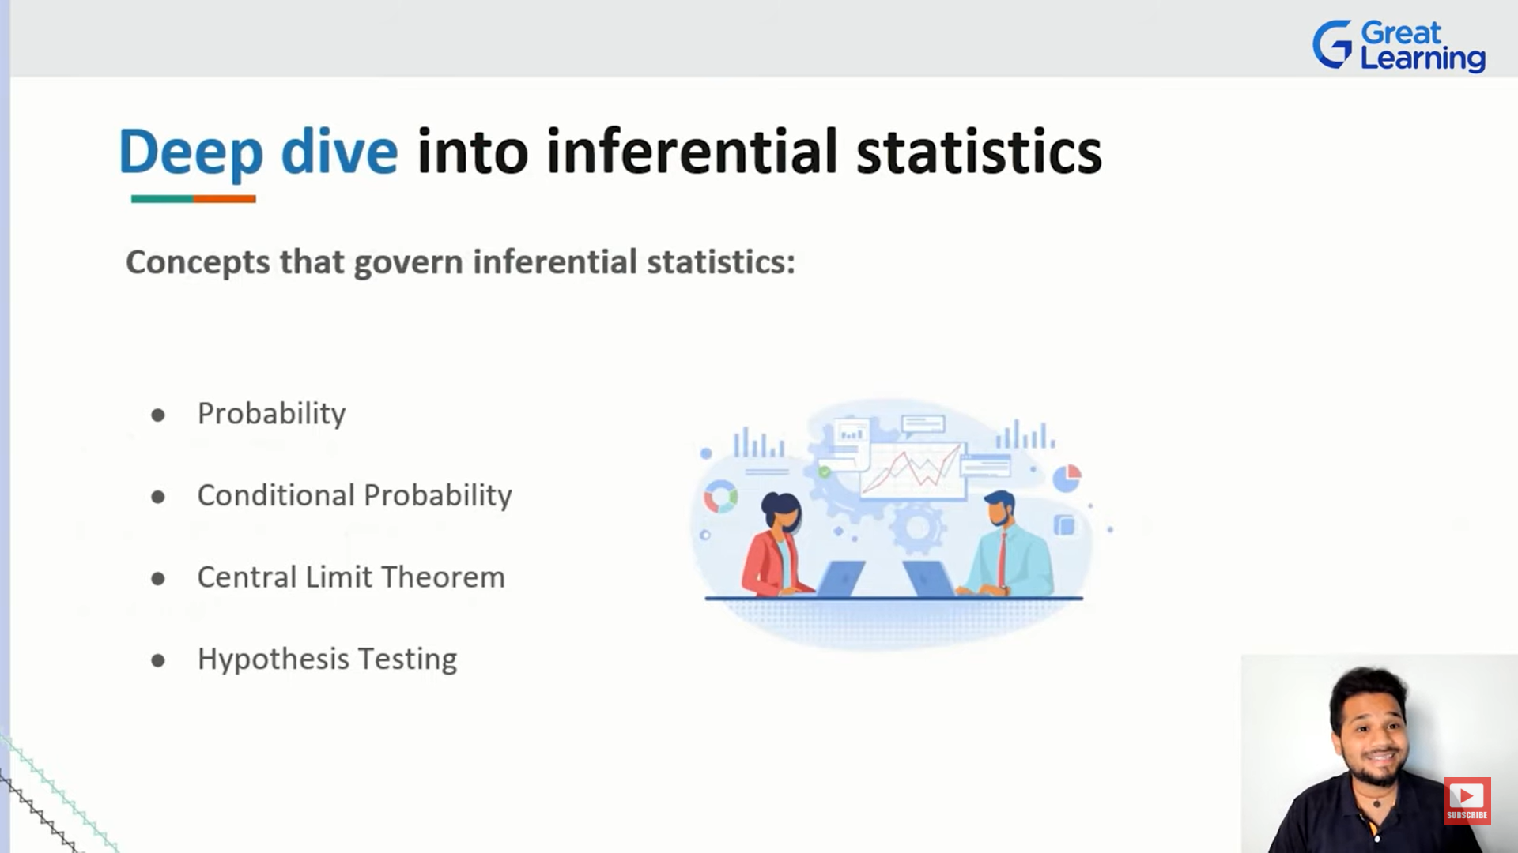

Slide 14
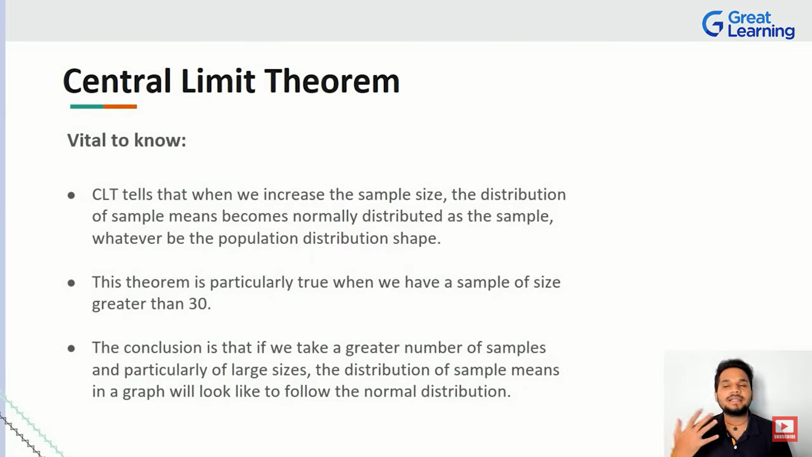

Slide 15
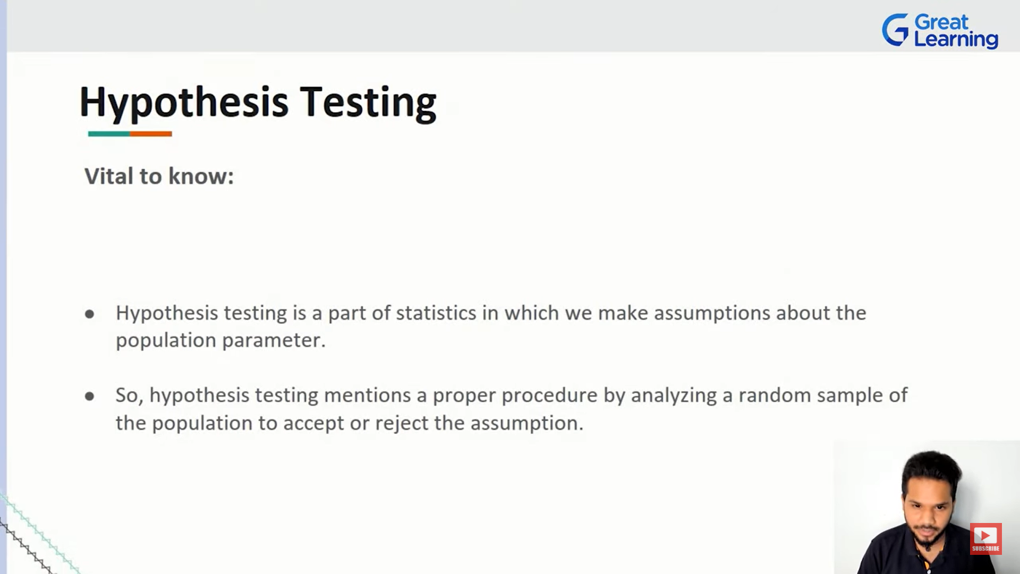

Slide 16
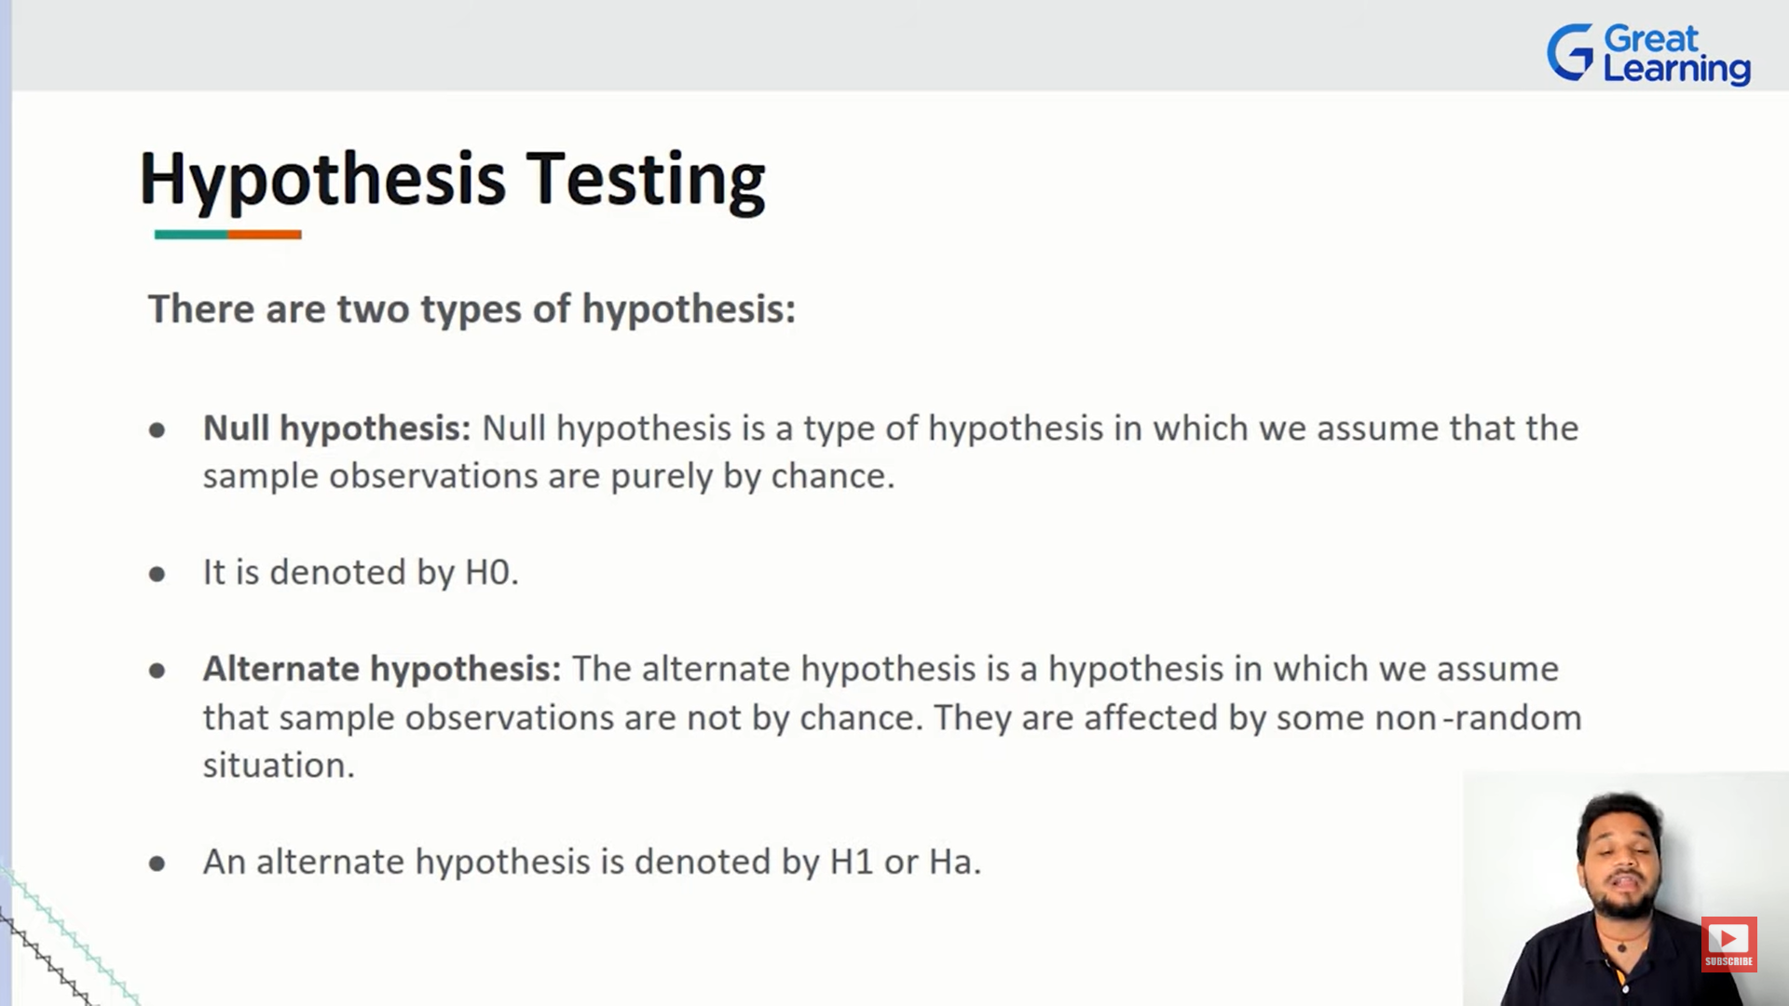

Slide 17
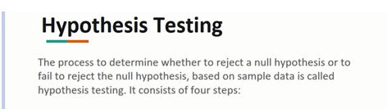

Slide 18
Step involved in Hypothesis testing:
Establish the Null (Ho) and Alternative (H1) hypothesis.
Establish the confidence level and the level of significance for the statistical studies. Level of significance = 100 - confidence level.
Depending on the type of data and the analysis which has to be made, choose the appropriate statistical test.
Using the functions and the data, calculate the p-value.
Compare the p-value (from step#4) against the level of significance (step#2) and take the decision.
NOTE :
If the p-value is less than the level of significance, then we reject the Ho.
If the p-value is more than the level of significance, then we do not reject the Ho.

Slide 19
Ho should be defined in such a way that if it is found to be true
a. no action is required
b. no change is required
c. no decision is required
d. keep running the process unchanged

Slide 20
Example :
1. A - I will fall sick tomorrow
2. B - I will not fall sick tomorrow
B is the answer
2. Swiggy claims that food would be delivered within 30 min
A - t<=30
B - t>30
Answer is A
3.Min salary that you can expect is 50K per month
Answer is salary >= 50K

Slide 21
Case 1: Error on right side (RIGHT TAIL TEST)
Swiggy :
The food is going to be delivered by 30 minutes
Delivery time < = 30
Delivery time > 30
So here …..in 1st condition ..there is no problem…..but let’s take 2nd case…..here the error zone lies to the right side of 30 ( u can consider number line) ……
So, these kind of test where the sign of the Ho is ‘<=’ and sign of alternative hypothesis(Ha) is ‘>’ ….these kind of cases are called as RIGHT TAIL TEST.

Slide 22
Null Hypothesis (Ho):
If it is found to be true ……then there is no requirement to make any changes, we should not required to make decisions, not to take any action…….No changes is required
It can be normal English and mathematical expression….
Eg:
I’ll come for the class (Ho)
I’ll not come for the class…..
So, if I’ll come….there is no changes….but yes…if I don’t come …then changes needs to be done……
I’ll fall sick
I’ll not fall sick (Ho)

Slide 23
Case 2: Error on left side (LEFT TAIL TEST)
Class Timing :
Time >= 4 hrs
Time < 4 hrs
So here …..in 1st condition ....there is no problem…..class can be of 4 hrs and more than that but it should not be less than 4 hrs mandatory…..here the error zone lies to the left side of 4 hrs ( u can consider number line) ……
So, these kind of test where the sign of the Ho is ‘>=’ and sign of alternative hypothesis(Ha) is ‘<’ ….these kind of cases are called as LEFT TAIL TEST.
Note :
‘=’ sign will always come with the Ho….

Slide 24
Case 3: Error on both sides (TWO TAIL TEST)
Example:
1. Sugar level should be = 80
Low sugar is problem as well as high sugar is also problem….
So, Sugar level < 80 > Sugar level………both will cause problem…..these kind of cases are called as ‘TWO TAIL TEST’.
2. Voltage supply (220V)….

Slide 25
3 types of tests are possible:
Left tail ( error is on left side or lower side)
Right tail ( error is on right side or higher side)
Two tail ( where u r going to check equality , mean of a particular value)

Slide 26
Default confidence level (CL) = 95%
If we increase CL……
Take into consideration the INTERVAL AND SAMPLE SIZE
Sample size increases, keeping interval same
Interval increases, keeping sample size constant

Slide 27
Level of significance (LoS) = 100 – CL
If CL = 95 %, then LoS = 5% =0.05
Physical meaning of LoS : Basically is an indicator of how much error u r allowing……
P value : Actual error occurred
Choice of test …step 3
For the above test , u need some function, that function require some input values and based on that u will get result as P value…..
P value ……step 4
So whatever P value u r getting…it is again compared to Los (step 2)….

Slide 28
Case 1:
If P value = 0.02 ……then P value is less than 0.05 ie (LoS )…..so because it is less than 0.05 ie P value < 0.05…..the decision u r going to take …..we reject the Ho.
Ho is made in such a way that it is found to be true …then u don’t need to take any action….but here we have put it as false …we rejected….so when u rejected Ho ..that means some action, some changes , some decisions are required….u can not run the process un touched…..This happened when u r getting P value < 0.05 and u rejected Ho…….

Slide 29
Case 2:
If P value = 0.3…………then P value is greater than 0.05 ie (Los )…..so because it is greater than 0.05 ie P value > 0.05…..then we do not reject the Ho…….
And if u r not rejecting Ho……that means no action, no decision, no changes are required…..and we continue the process……

Slide 30
Case 3:
If P value = 0.05……then we need to take an action

Slide 31
What is P value ? Why would we compare P value with LoS? What is the common thing between them?
Inferential statistics (IS) is all about taking decisions based on numbers……here, we have information of a small sample and we need to make decision for entire population……its like u watch trailer of a movie and based on that u decided to watch or not to watch that movie…..
But if we take information about the whole population…then there is no need of IS…..bcoz there is no chance variation…..
If we are taking decision based on the data coming from a sample for entire population, there could be a mistake or may not….
Technically ….Those mistakes are Type 1 and Type 2 error….

Slide 32
Type 1 error :
This error is committed when u reject Ho which is actually TRUE
Example :
1. based on just trailer …u decided u ll not watch the movie…..but Movie was actually good one…rejecting a good movie based on trailer is Type 1 error…
2. Rejecting an important phone call …..
P value gives u the probability of committing Type 1 error…..
If P value = 0.03 …..if u reject Ho here ……there is a 3% chance that u r committing Type 1 error…..

Slide 33
Type 2 error:
This error is committed when we do not reject Ho when it is actually FALSE….
Here Ho is false …u should have rejected this ….but u did not because data was coming from sample …..so based on sample, u need to reject hypothesis …but u did not…that is Type 2 error…
Example:
1. Picking up a marketing call
2. Watching a worthless movie ……

Slide 34
Reject a good movie …..type 1 error
Watch a worthless movie….type 2 error
Type 1 and Type 2 is like a sea-saw
-Type 1 is Indirectly proportional to Type 2
-Both cannot be happened together…..if one up then 2nd goes down……

Slide 35
P value is the actual probability of meeting the Type 1 error…..
The LoS is the maximum allowed probability of committing Type 1 error……
That’s why we are comparing the two…..

Slide 36
If P value = 0.02….if we reject Ho then chances of rejecting something TRUE is 2%....and LoS is 5%...and max allowed prob of rejecting something TRUE is 5%.....And so we reject the Ho…..
When P value < LoS….then chances of committing error is less what is allowed to you…then u can take a risk and u r allowed to reject a Ho…..P value can be anything…..
If P value = 0.3…..if I do the rejection … chances of rejecting something TRUE is 30%.....max allowed prob of rejecting something TRUE is 5%.....so here we cannot take a risk…so we do not reject Ho….

Slide 37
P-value : Actual probability of committing type 1 error…….
LoS : Maximum allowed probability of committing type 1 error ……

Slide 38
Steps involved in Hypothesis Testing:
Step 1 : established Ho (also define left tail or right tail test) and Ha
Step 2 : established CL……by default it is 95%...if we increase it…size of sample will go up….
Step 3 : If p value is less than the LoS (p-value < LoS) …then reject the Ho….probability of making type 1 error which is less than what is allowed…..that is why we reject the Ho….
How u draw inferences?..... answer is based on p value…..
How u take a decision based on p value ? ……. If p value is less than the LoS (p-value < LoS) …then reject the Ho …….else no rejection
Why we do that?…bcoz p value tell us the probability of making type 1 error which is less than what is max allowed probability….we can take a risk…and reject the Ho…..
Step 4 :
Step 5 :

Slide 39
CONTINUOUS DATA :
the most important parameter is SAMPLE MEAN Or VALUE OF VARIANCE…
If u worried about central tendency….go for MEAN….If u worried about variation …..go for VARIANCE…
1 SAMPLE T TEST :
Purpose :
This test is used when we wished to compare the sample mean against a claim value and established whether the difference is statistically significant or not……

Slide 40
Eg : Swiggy example ( claim is 30)…
Collect sample of 100 deliveries ……..find out its mean…suppose it came out to be 32 (greater than claimed value 30)…then I check the difference between 30 and 32….
SS = 32
Claim value = 30
Ho says mean < = 30 but mean = 32
Should I reject here ? why do we need to find p-value? Why cant we reject here only? Some decision is required …..No we cant do that…Why?
SS = PP + Bias will replace by the word ‘ ACTUAL DIFFERENCE’ + Chance variation
Bias was without number…..

Slide 41
We used BIAS …..bcoz that time data was not there with us…..now I have data…that’s why replaced with the term ‘ ACTUAL DIFFERENCE’ ……..
In HT…we are using Actual difference ….
SS = 32
PP = 30
32 = 30 + AD + CV
Here, we have collected data of just a sample(100 deliveries)…… there may be a chance that this could be bcoz of CV…….may be it is very small…there is a no role of AD….the difference of 30 and 32 may be bcoz of CV…..
Small difference we can consider…
Suppose upto 30.5 , it is a matter of CV……but above that number…it is not acceptable…there is something come up with CV….ie AD….we cannot ignore this difference….
How we decide 30.5?
Based on CL…….based on LoS

Slide 42
Example:
Swiggy claims that max time of delivery = 30 minutes…..so based on the data collected draw the conclusion whether their claim is justified or not?

Slide 43
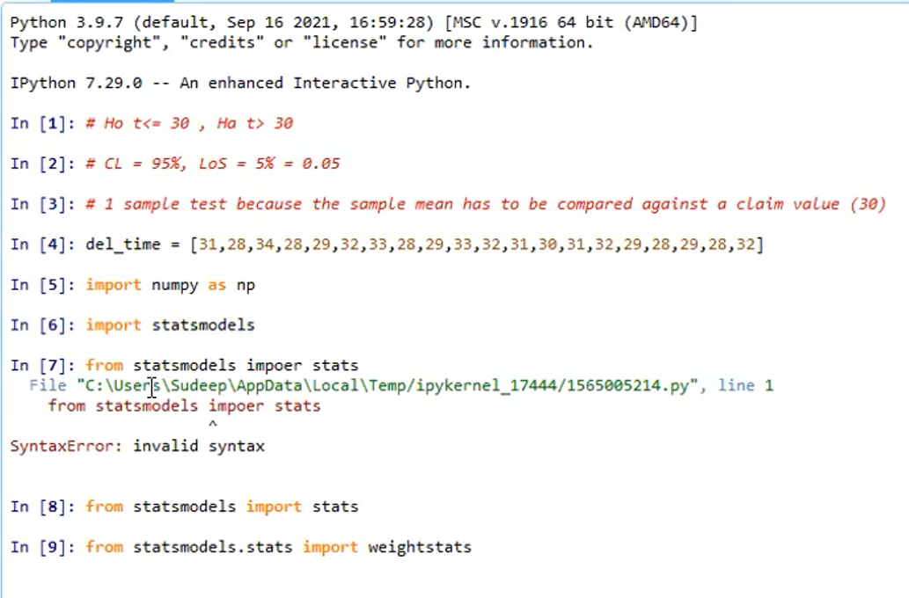

Slide 44
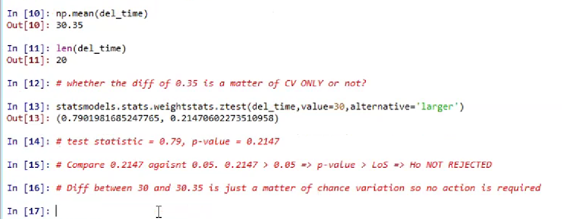

Slide 45
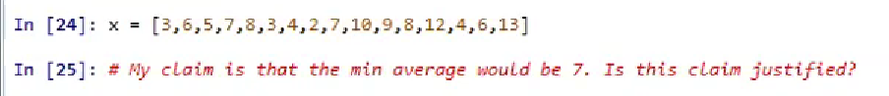
Task : (1 TAIL TEST)
p- value =0.34 > 0.05…….we don’t reject the Ho….the claim is justified......bcz here rejecting something is about 35%

Slide 46
p- value =0.018 < 0.05…….we reject the Ho….the claim is not justified......here rejecting something is only 2%......so we can reject it….

Slide 47
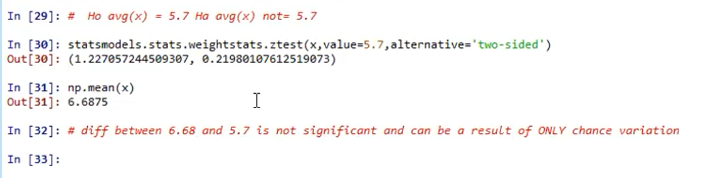
Task : (2 TAIL TEST)

Slide 48
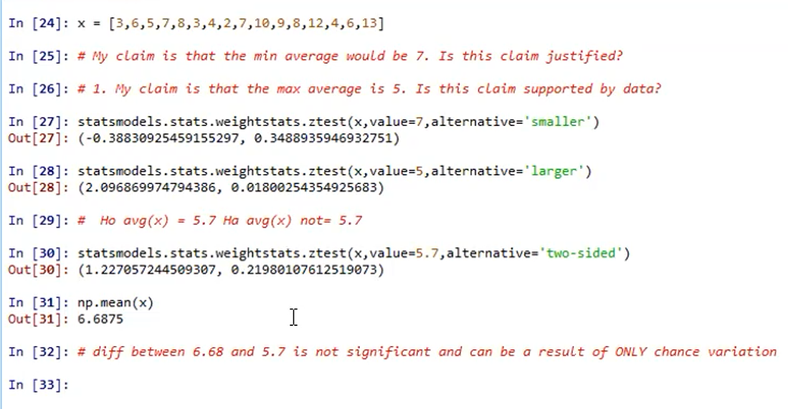
Here mean = 6.68…….difference between 6.68 and 5.7 is statistically not significant….they can be considered as equal….bcoz p-value = 0.2 > 0.05 …….the Ho stays………doesn’t get rejected (almost 21%)

Slide 49
Note :
If difference between MEAN & CLAIM VALUE is less…….then we can ignore it…it is just a matter of CV….
If difference between MEAN & CLAIM VALUE is more…….then we cannot ignore it…it is not just a matter of CV….here AD also play an important role……

Slide 50
2 SAMPLE T TEST :
When the difference of the mean(average) of two independent samples has to be compared
against claim value…..
Eg : Sample A ……find mean1
Sample B ….. find mean2
Then find the difference between these means(mean1 – mean2) and compared against claim
value….
Claim : Metro trains takes 5 minutes less compared to local trains…..
Ho avg(local) – avg(metro) > = 5 (always take greater one first) & Ha avg(local) – avg(metro) < 5
CL = 95% , LoS = 5% = 0.05
Bcoz two different sample….so go for 2 sample T test
Run the function……

Slide 51
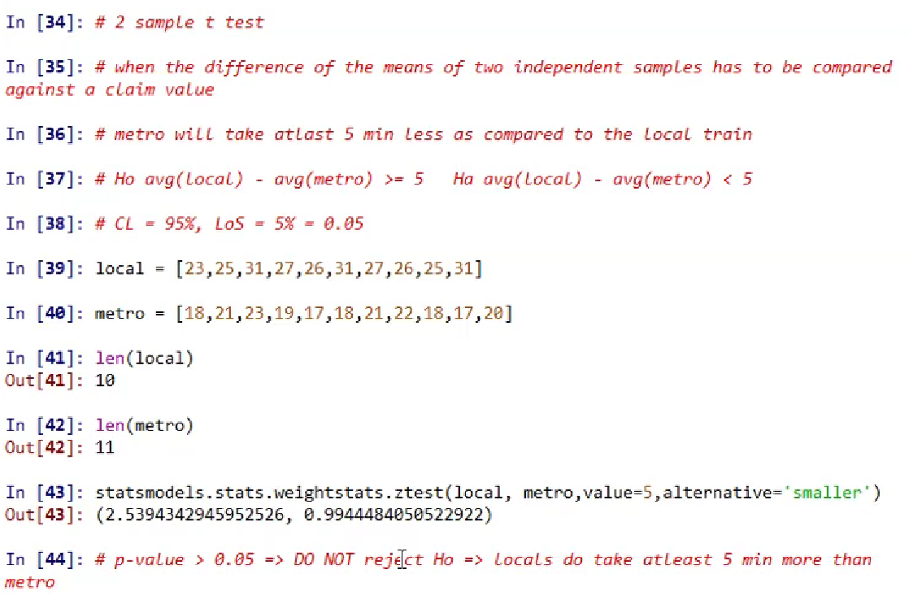

Slide 52
Here, p-value = 0.99 …..apprx =1
p-value >> 0.05 ……almost 99%.....so CANNOT REJECT Ho…….
Decision : Locals do take at least 5 minutes more than metro…..

Slide 53
ANOVA (Analysis of Variance):
ANOVA, which stands for Analysis of Variance, is a statistical test used to analyze the difference between the means of more than two groups.
Types of ANOVA:
One-way ANOVA
Two-way ANOVA
A one-way ANOVA uses one independent variable , while a two-way ANOVA uses two independent variables.

Slide 54
One-way ANOVA :
When to use a one-way ANOVA :
When you have collected data about one categorical independent variable and one quantitative dependent variable.
The independent variable should have at least three levels (i.e. at least three different groups or categories).
ANOVA tells you if the dependent variable changes according to the level of the independent variable.
So in short, one-way ANOVA used :
When we have multiple sample
Purpose : to establish whether all pairs of the means can be consider as equal or not…..
Example :
Suppose we have 3 samples ….say A B C
Pairs ……AB, AC and BC
So here , can we say averages of AB = BC = AC
Ho: They are always constant and that is all the pairs of the means are equal….
Ha : At least one pair where the means are not equal…

Slide 55
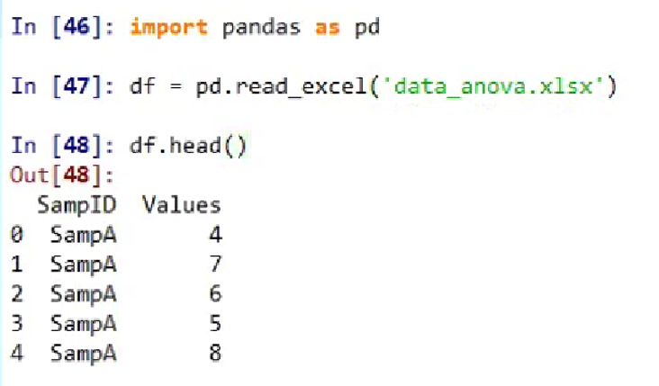

Slide 56
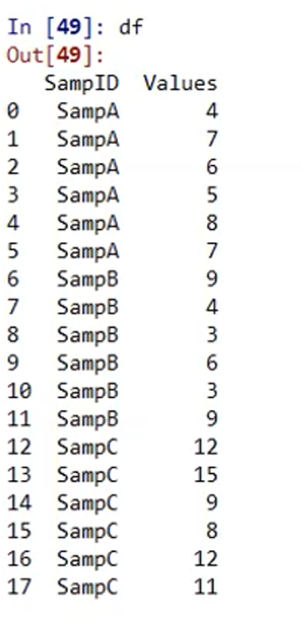

Slide 57
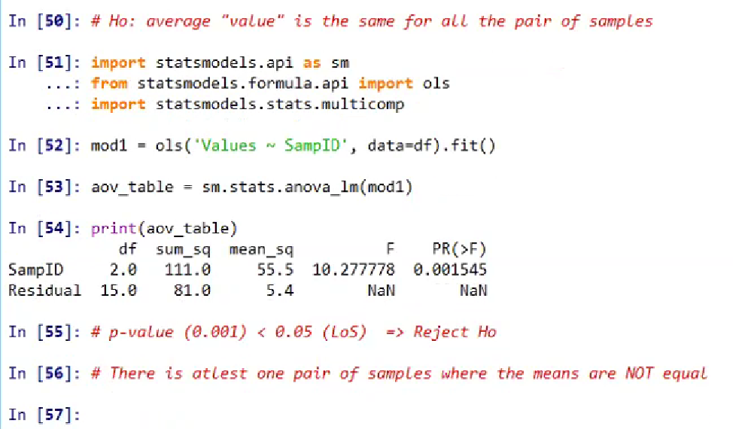
Here last column is nothing but your p-value(PR)…..i.e. 0.001545…this p-value is calculated on the basis of test statistics (here F)…..which has been converted into p-value….
In 52 and In 53 are important….basically (step 4)….
p-value < 0.05…..REJECT…..

Slide 58
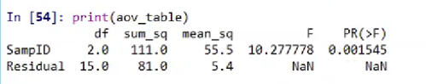
The ANOVA output provides an estimate of how much variation in the dependent variable that can be explained by the independent variable.
The first column lists the independent variable along with the model residuals (aka the model error).
The Df column displays the degrees of freedom for the independent variable (calculated by taking the number of levels within the variable and subtracting 1), and the degrees of freedom for the residuals (calculated by taking the total number of observations minus 1, then subtracting the number of levels in each of the independent variables).

Slide 59
The Sum Sq column displays the sum of squares (a.k.a. the total variation) between the group means and the overall mean explained by that variable. The sum of squares for the SampleID is 111.0, while the sum of squares of the residuals is 81.0
The Mean Sq column is the mean of the sum of squares, which is calculated by dividing the sum of squares by the degrees of freedom.
The F value column is the test statistic from the F test: the mean square of each independent variable divided by the mean square of the residuals.
The larger the F value, the more likely it is that the variation associated with the independent variable is real and not due to chance.
The Pr(>F) column is the p value of the F statistic. This shows how likely it is that the F value calculated from the test would have occurred if the Null hypothesis of no difference among group means were true.

Slide 60
Tukey Test :
We cannot compare all the 3 at the same time…the comparison will always happen pairwise…..A with B, B with C and A with C…..
Which are those pair or pairs where the averages are not equal?
Ans : tukey test (pairwise_tukeyhsd)
df.Values …response
df.SampId …Groups

Slide 61
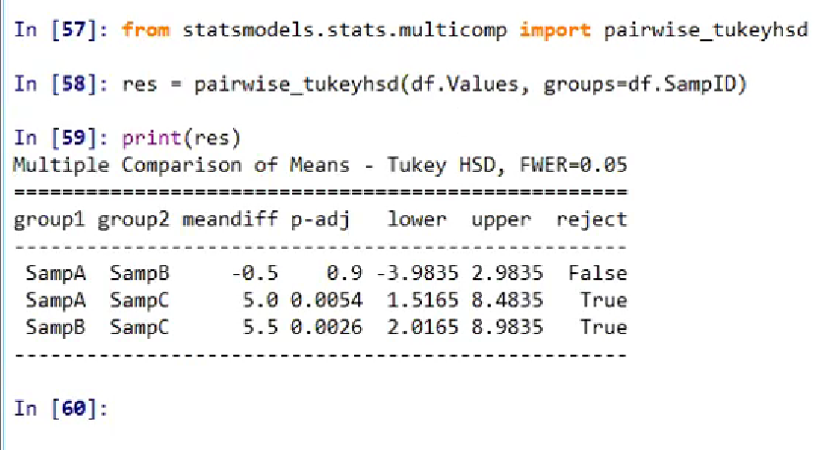

Slide 62
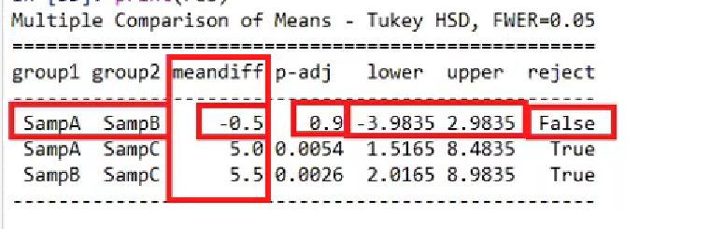
Consider first row…….
1st 2 columns are pair of samples….
Meandiff……shows difference between 1st 2 columns…. i.e. SampA - SampB = - 0.5
Ho : internally mean of SampA and SampB are equal to each other…
Here p-value = 0.9 > 0.05……that means No REJECTION….so Rejection = False
This diff is only for sample…if I go for population diff….. then that diff could be anything between -3.9(-4) and 2.98(3)….(lower and upper…see above)

Slide 63
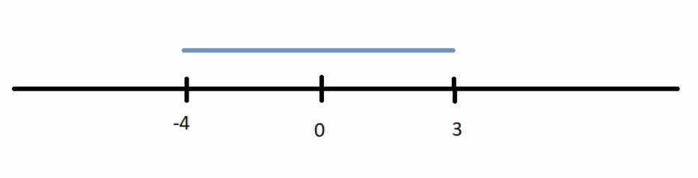
Now consider In 16……. SampA – SampB = -0.5 and interval is between -4 and 3(lower and upper column)
So 0 can be between -4 and 3…….chances of diff between A and B = 0 may happen…..So we cannot reject that Ho….NO REJECTION

Slide 64
One num is -ve and another num is +ve (-4 and 3)…..that means 0 is falling between this interval…. Chances of A and B are equal cannot be ruled out …..bcoz if A and B are equal…then SampA - SampB =0….and 0 is falling in this interval…and there is a chance of having average equal……..NO REJECTION

Slide 65
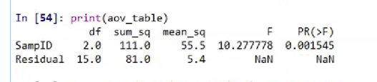
Ho : average of all pairs (AB,BC and AC) are equal
Here p-value < 0.05….so Ho got rejected…that means out of these 3 pairs ….at least 1 pair where the diff of avg is significant and it cannot be considered as 0…..

Slide 66
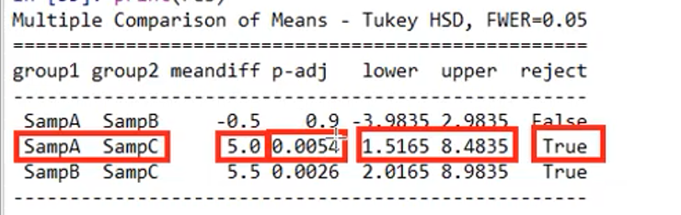
2nd row:
SampA - SampC= 5.0…….it is between interval 1.5165 and 8.4835…..both are positive…that means 0 will not fall between this interval….hence A and C diff will not equal to 0…..ie Avg of A and C is not equal to 0…..hence Ho is REJECTED….
p-value < 0.05 ……hence REJECTED
Same analysis we can take for 3rd row as we did fir 2nd row…..

Slide 67
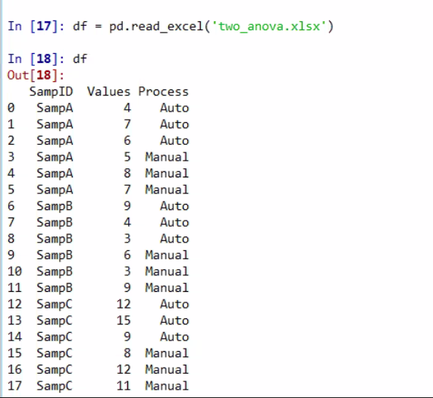
Two-way ANOVA : same as one-way ANOVA but here we have 2 factors instead of 1 which can influence Value
SampID…….source (3 locations)
Here we are considering 2 factors which can influence
our Values….(1st is SampId and 2nd is Process)
Here two factors are there….so 2 Ho
For SampId [Ho(1)] : The average value is the same for
all pairs of sample or The value is not influenced by the
sample….
For Process[H0(2)] : Average value is same for each pair
of process or The value is not influenced by process….

Slide 68
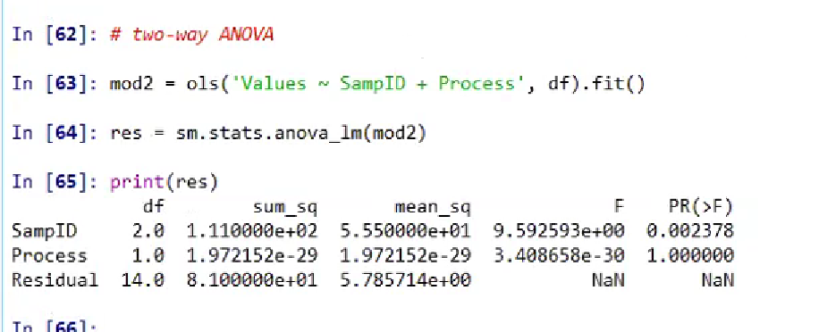
Ho for SampId : p-value<0.05……REJECTED
For SampId….Ho was that values are same for all pairs of sample….since p-value< 0.05…so reject this
Ho…..and conclude that at least for one pair the avg value is not same
Ho for Process : p-value>0.05…..NO REJECTION
For Process….Ho was that the values are same for all the pairs of processes…here p-value> 0.05…so Ho
not rejected and conclude that…avg value is same for both processes…

Slide 69
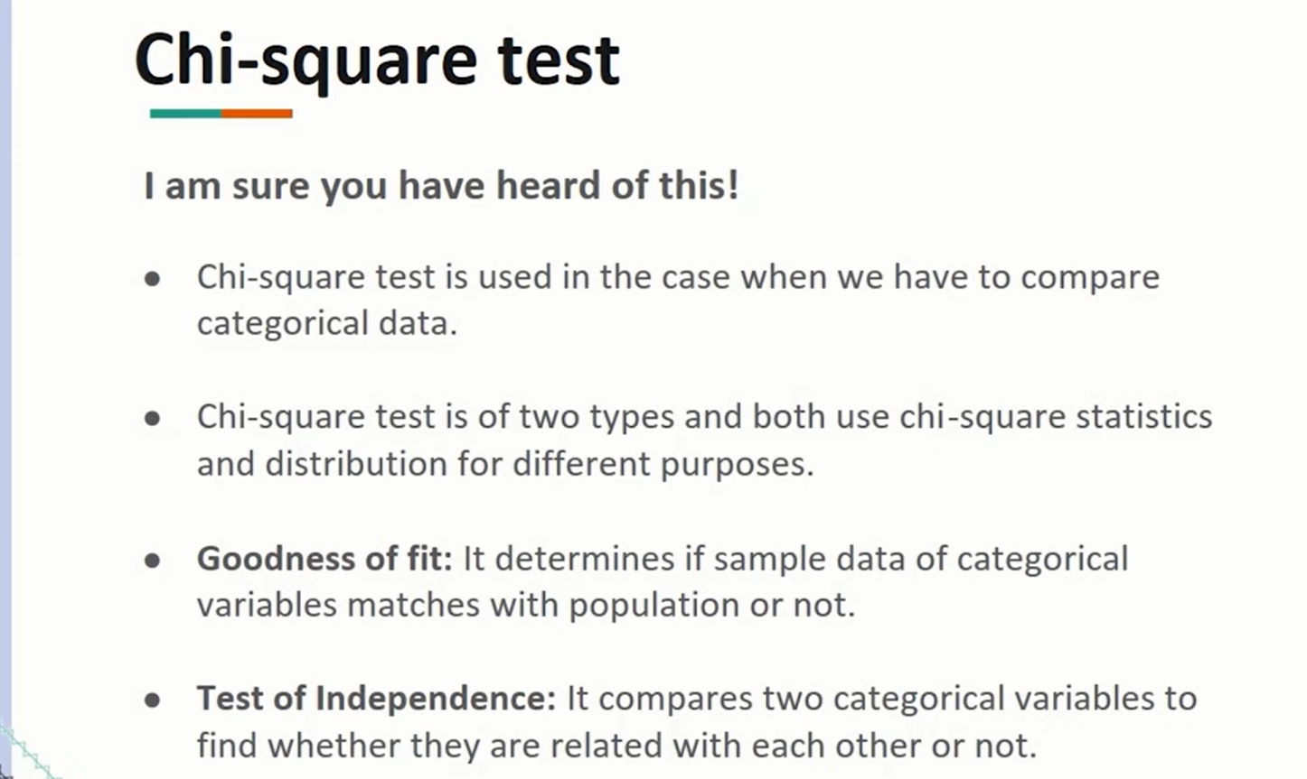

Slide 70
Chi Square Distribution :
Goodness of fit test (GOF) (one variable)
Test for degree of association (two variables)

Slide 71
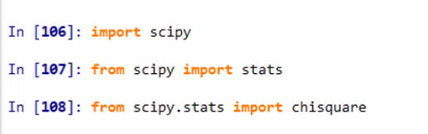
GOF test is used to check whether the counts for multiple categories follow the pattern that has been claimed or not. The Ho in this case is that the counts follow the pattern.
Basically this test is used when u have a multiple conditions where there are categories
possible for response ….
Eg : you have automobiles company and in that there are 4 different brands of cars ….you could be
claiming diff market shares for these brands ….like 10% for brand A, 30% for brand B and so on…
So this is the market share u r claiming…..so we want to check market share for these brands that u r
claiming or not…..I will visit some places where these brands are available and I’ll count and check whether
the counts I got from the sample is following the pattern or not ……

Slide 72
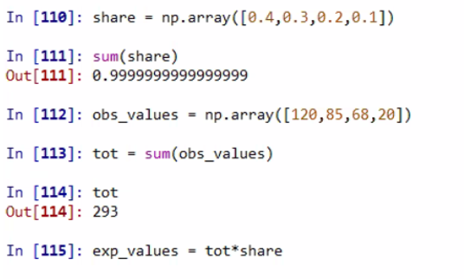
Ho : count follow the pattern

Slide 73
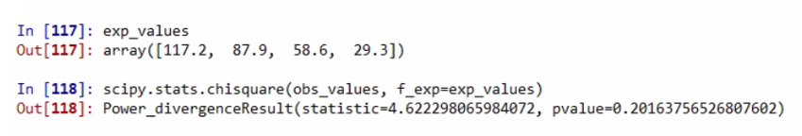
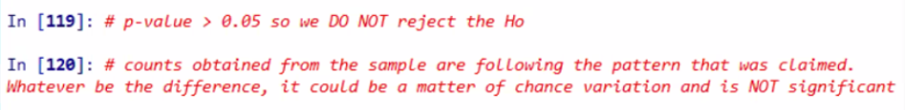
Expected value can be in decimal…see In 117
On the basis of p-values, diff between expected and observed is insignificant right ?
YES bcoz p-value > 0.05

Slide 74
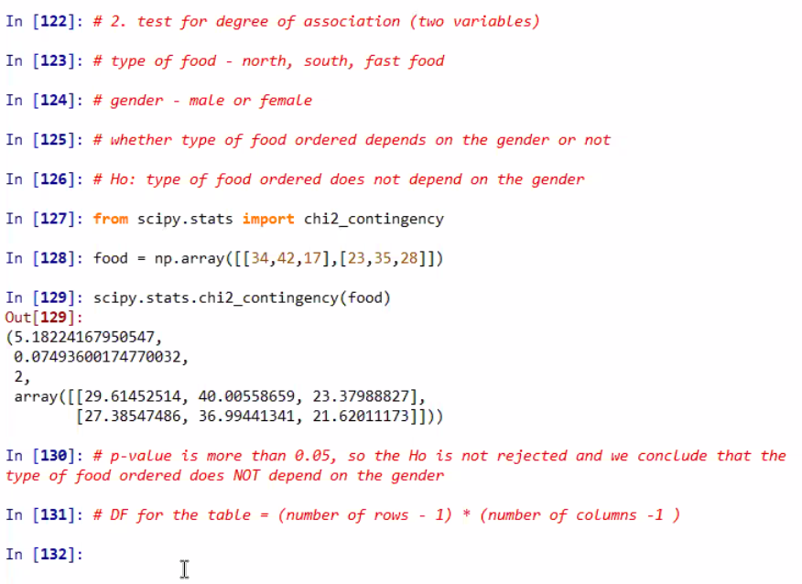
2. test for degree of association (two variables)

Slide 75
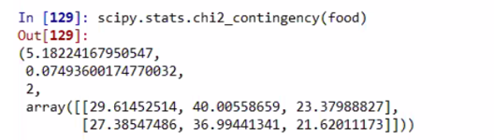
First output is test statistic (5.18224..)
Second output (0.0749 ( is the p-value))
Third output is the DF for the table :DF for the table = (number of rows - 1) * (number of columns -1 )
Fourth result is the array of expected values(1st row is for males and 2nd row is for females)
p-value > 0.05, so the Ho is not rejected and we conclude that the type of food ordered does NOT depend on the gender

Slide 76
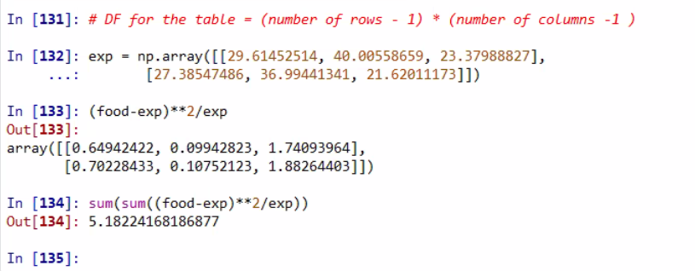
o/p of In 134 and In 129…

Slide 77
Thank You

